Slide 1

RNA-seq Tutorial using
GeneLab’s Analysis Platform
Version 4.2
October 2021

Slide 2
OVERVIEW OF THE Pipeline
Quality Control
Tools: FastQC
Trimming
Tools: Trim Galore!, Trimmomatic, Cutadapt
Alignment (Mapping)
Tools: RNA STAR, Bowtie, HiSAT2
Count
Tools: Feature Counts, HTSeq, Rsem
Differential gene expression
Tools: DESeq2, Limma-voom, edgeR
Although this tutorial provides basic instructions for how to perform RNA-Seq analysis, it is not meant as a comprehensive guide.
Throughout this tutorial:
Yellow boxes indicate information
Blue boxes indicate enumerated actions
Red boxes call out a location on screen
This tutorial will use the tools in green; however, there are other software packages and parameters that can be used in each step of the analysis pipeline that may be better suited for the user’s needs.

Slide 3
GeneLAB RNA-SEQ Workflow
Input file
Tool
Output file
Quality Control: FastQC
Fastq
Trim Galore!
Trimmed Fastq
Quality Control: FastQC
Trimmed Fastq
RNA STAR
BAM file
BAM
FEATURE COUNTS
COUNT
COUNT
DESEQ2
TABLES & PLOTS

Slide 4
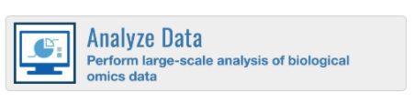
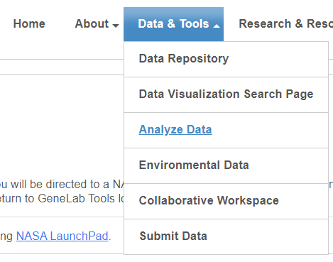
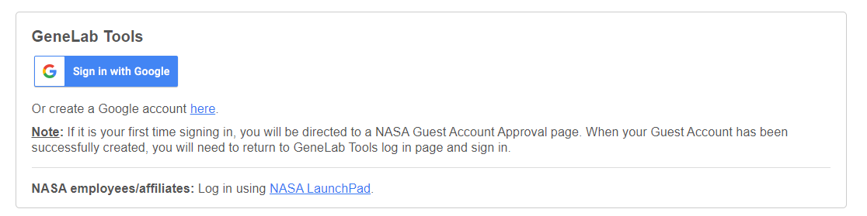
Logging into the Analysis Platform
1
Navigate to https://genelab.nasa.gov/ and click on the Analyze Data button or select Analyze Data from the Data & Tools menu.
Or navigate directly to https://galaxy.genelab.nasa.gov/
2
Log in using your Google ID or NASA Credentials

Slide 5
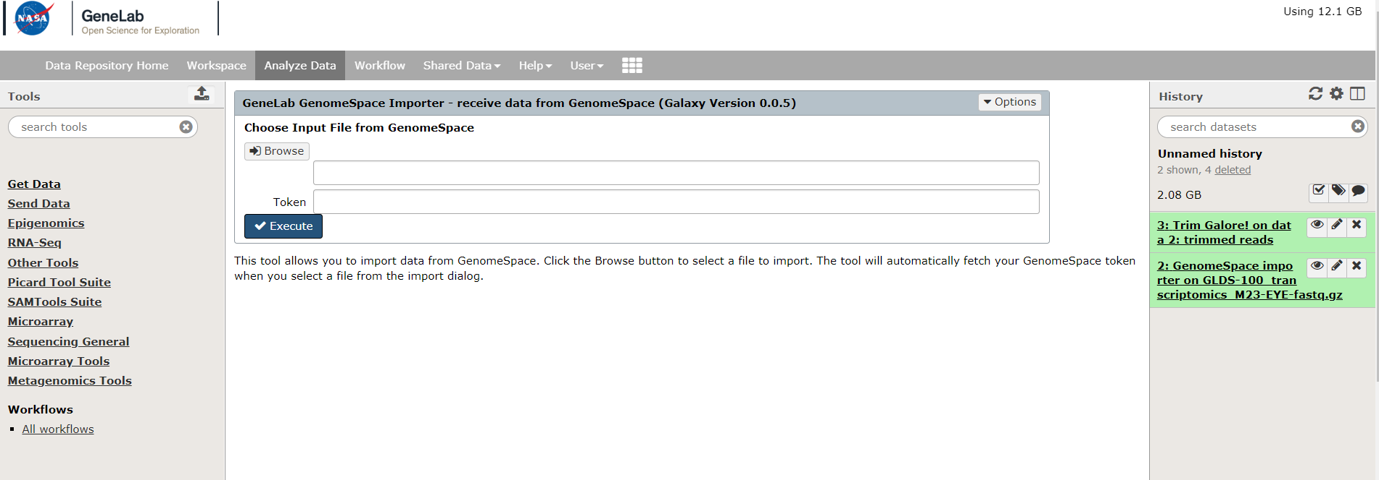
Analysis Platform Overview
Upload data
Click Analyze Data to navigate to this user interface
Navigation menu
Main panel:
Execute tools, adjust parameters, and view results
Toolshed:
Menu that shows all available tools
History:
Display your queued, currently running, and/or completed jobs

Slide 6
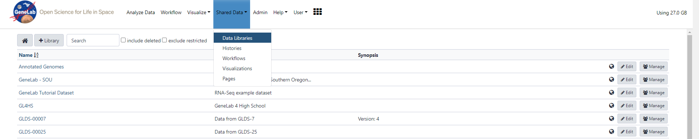

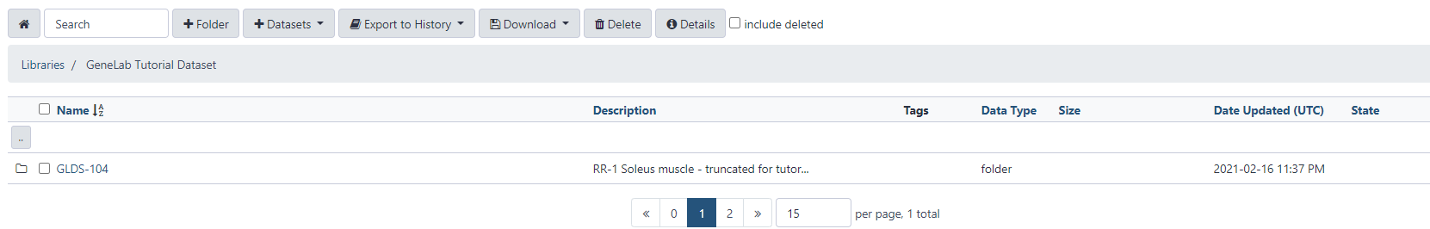
Finding your data: example dataset
1
Click Shared Data to navigate to the tutorial dataset in the Data Libraries
2
3

Slide 7
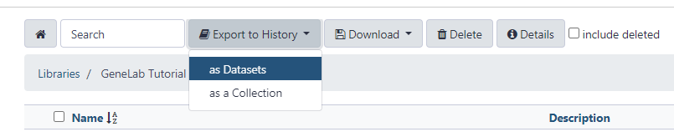
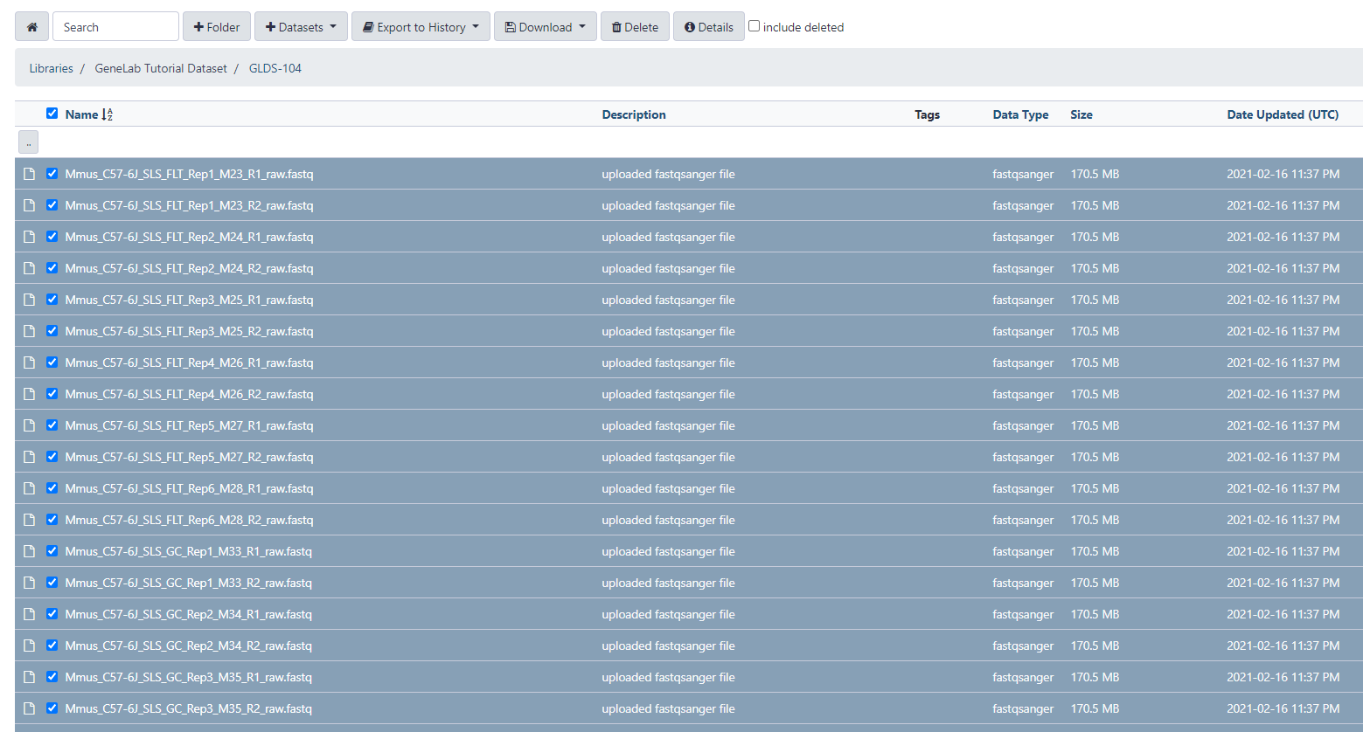
Adding data to history
1
2
Select files:
Check all or individually select all files
Export to History as Datasets

Slide 8
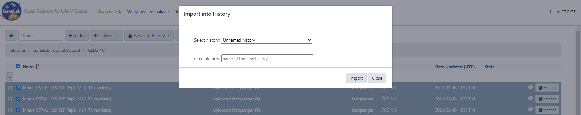
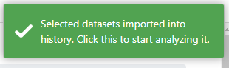
Export to History
For this tutorial, we will be creating a new history. Type a history name, for example GLDS-104 Tutorial. Click Import.
Your selected files have been successfully imported. Click on the green box or navigate to Analyze Data in top menu to see your current history.

Slide 9
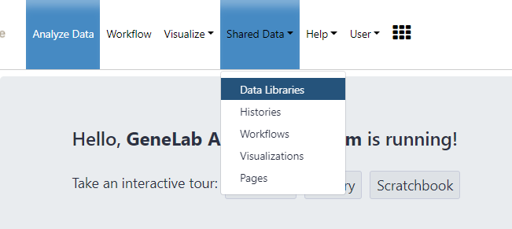
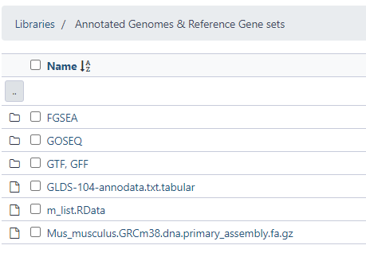
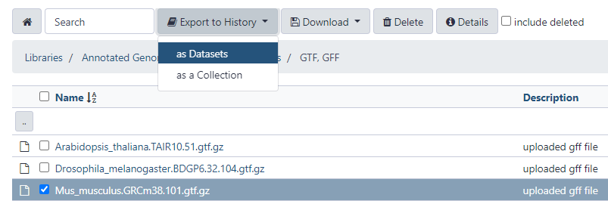
Adding Reference Genomes
1
Click on Shared Data, then navigate to Data Libraries
In Annotated Genomes & Reference Gene Sets, open the GTF,GFF folder.
2
Select the .gtf file of the correct organism (in this case, Mus musculus), to Export to History. Export into your active history as Datasets.
3
Click Analyze Data to return to your main analysis panel

Slide 10
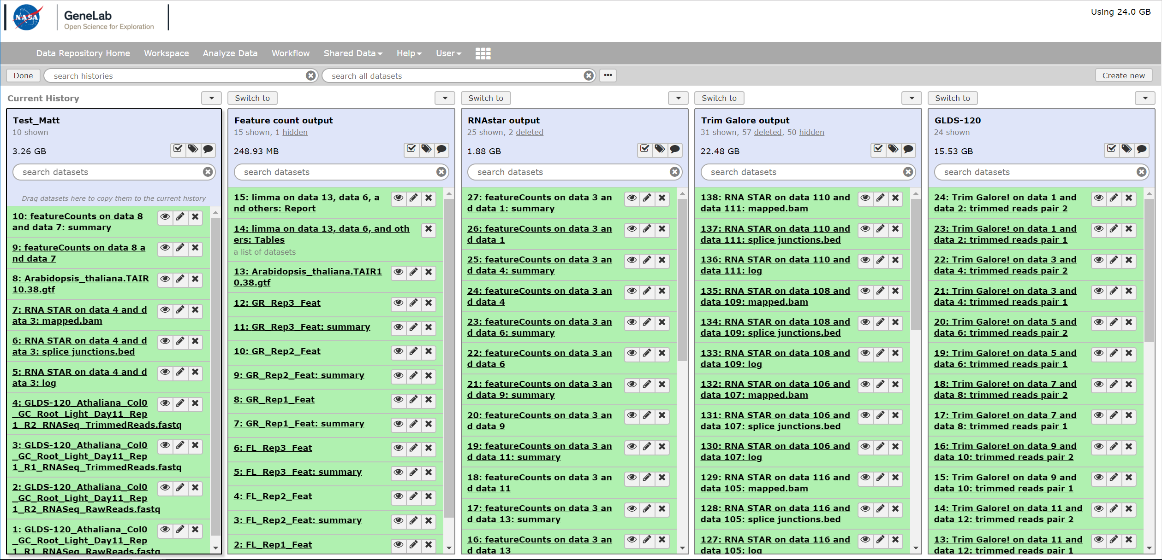
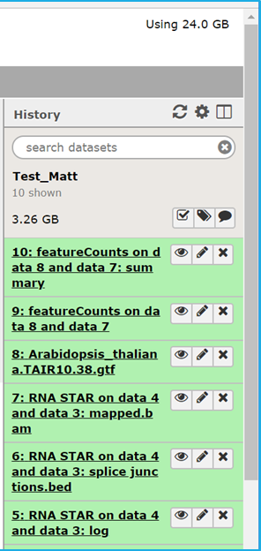
Viewing History
Click the Switch to button to move that History to your current History
To view your histories click on this icon at the top right corner of the History panel
Current History

Slide 11
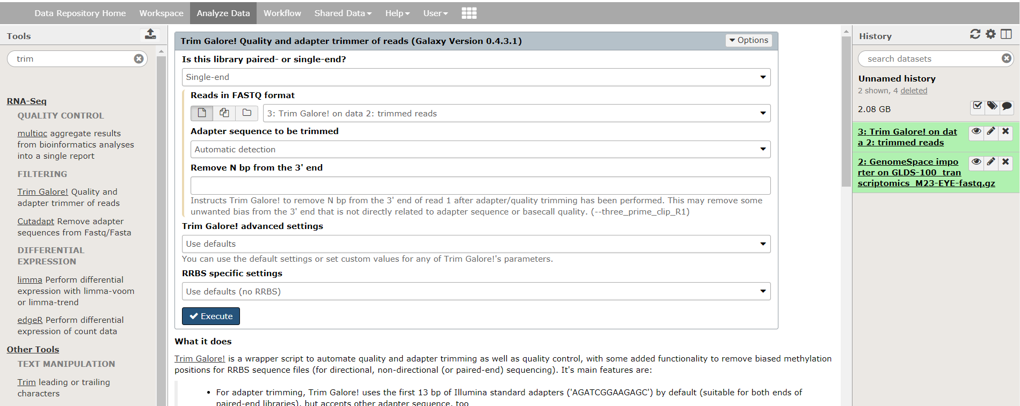
OVERVIEW OF Searching FOR and running tools
Running and completed jobs will appear in History
Search tools by using keywords in the search bar
Or
Use the menu and scroll through the various categories
Fill in parameters and click Execute

Slide 12
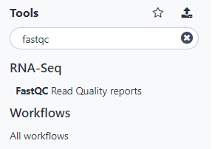
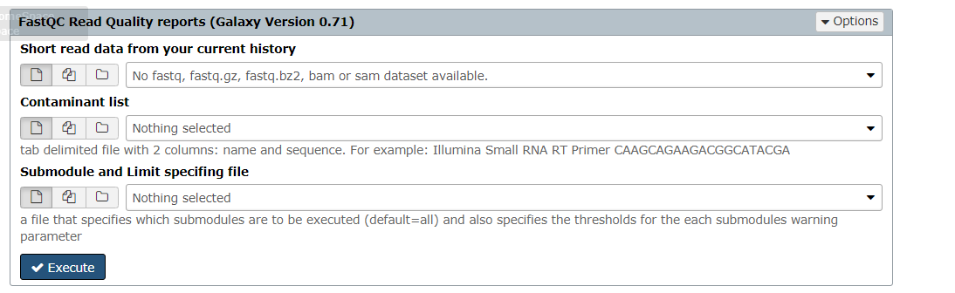
Quality control: Call FASTQC
1
Search for and click on FastQC in the Tools menu.
2
Use the following parameters and click Execute
Short read data from your current history
Select your fastq files or dataset collection. Use the Multiple Datasets icon to select all of your fastq files
Contaminant list
Use default
Adapter List
Use default
Submodule and Limit specifying file
Use default

Slide 13
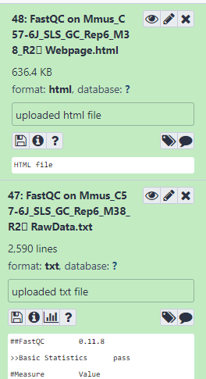
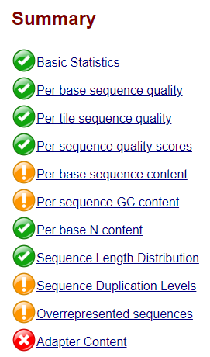
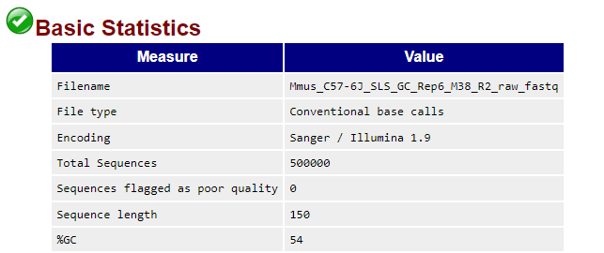
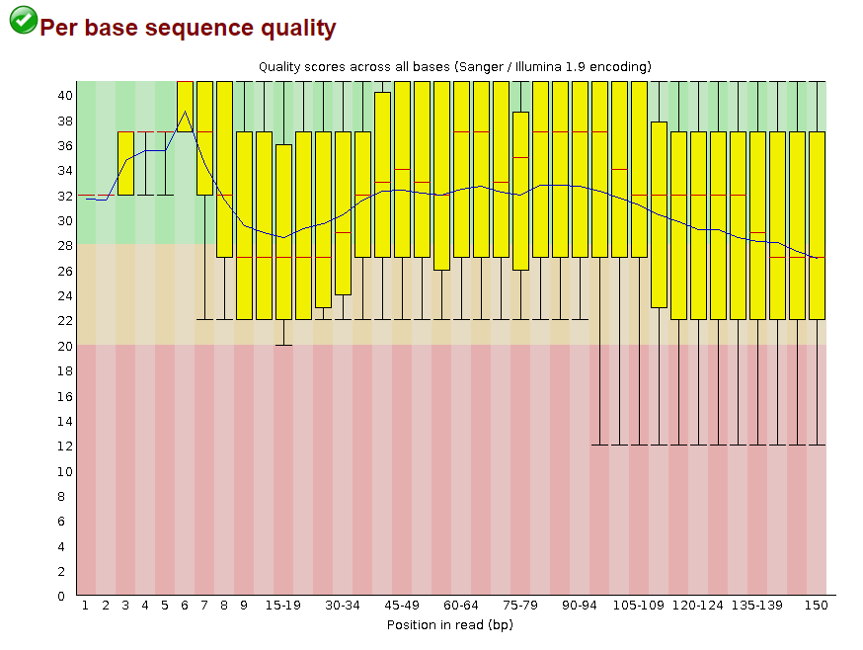
FASTQC Results
Click on output filename to expand details and options
Click on eye icon to view data
Notice that adapter content needs to be trimmed

Slide 14
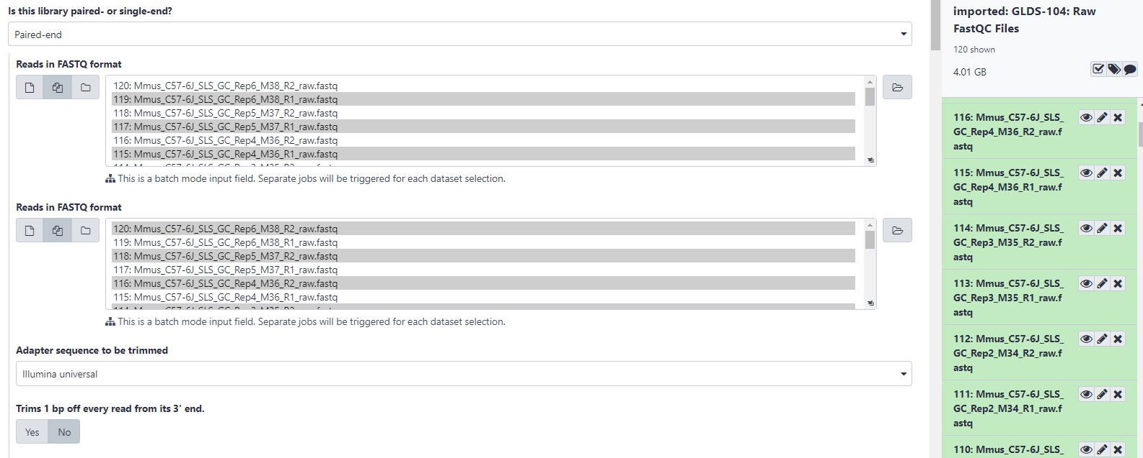
Trimming: Call Trim Galore!
1
Search for and click on Trim Galore! in the Tools menu.
Use the following parameters and click Execute
2
Is this library paired- or single-end?
Paired-end
Reads in FASTQ format
Add R1 and R2 fastq files of the same sample
Adapter sequence to be trimmed
Illumina universal
Trim Galore! advanced settings
Use Full parameter list
Generate Report?
Yes
Leave other parameters on default settings

Slide 15
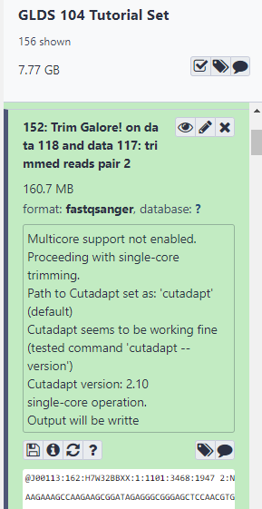
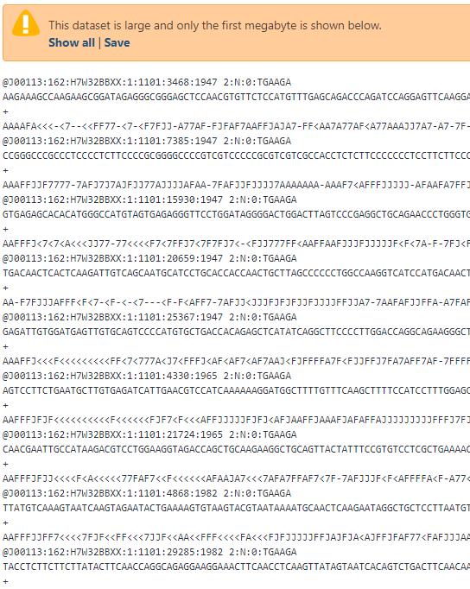
Trim Galore! Results
Perform FastQC again to check the quality of your trimmed fastq files.

Slide 16
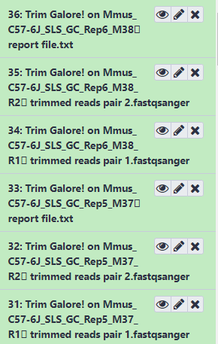
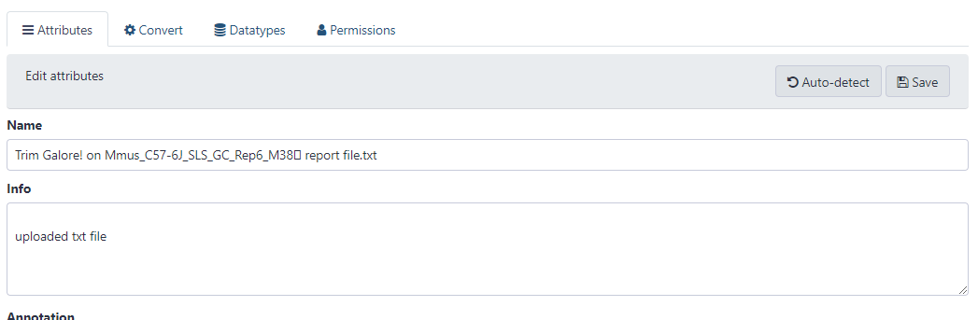
changing file names/metadata
Edit output file names to reflect sample info to help keep track of your info.
Click on eye icon to Edit Attributes
Type in a short but descriptive name, then click on Save.

Slide 17
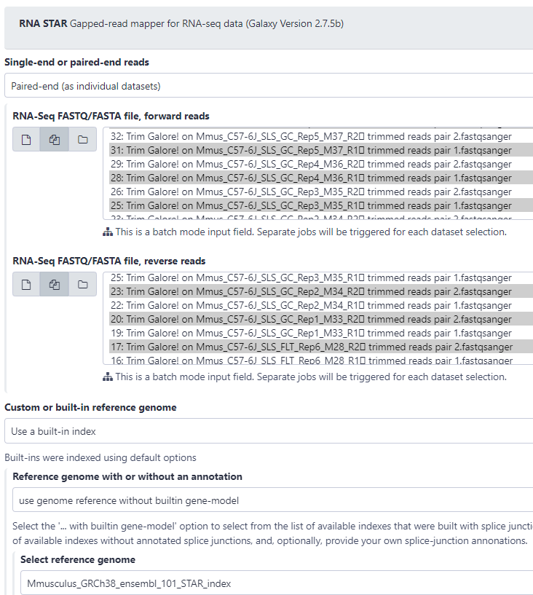
Alignment: Call RNA star
2
Use the following parameters and click Execute
1
Search for and click on RNA STAR in the Tools menu.
Is this library paired- or single-end?
Paired-end (as individual datasets)
RNA-Seq FASTQ/FASTA file, forward reads
Select pair 1 reads from trimming step
RNA-Seq FASTQ/FASTA file, reverse reads
Select pair 2 reads from trimming step
Custom or built-in reference genome
Use built-in index
Reference genome or without an annotation
Use genome reference without built in gene-model
Select reference genome
Mmusculus_GRCh38_ensemble_101_STAR_index
Gene model
Mus_musculus.GRCm38.100.gtf
Length of the genomic sequence around annotated junctions
149
Leave other parameters (seed, alignment, limits, and chimeric alignment) on default settings

Slide 18
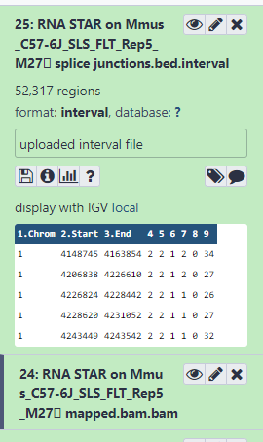
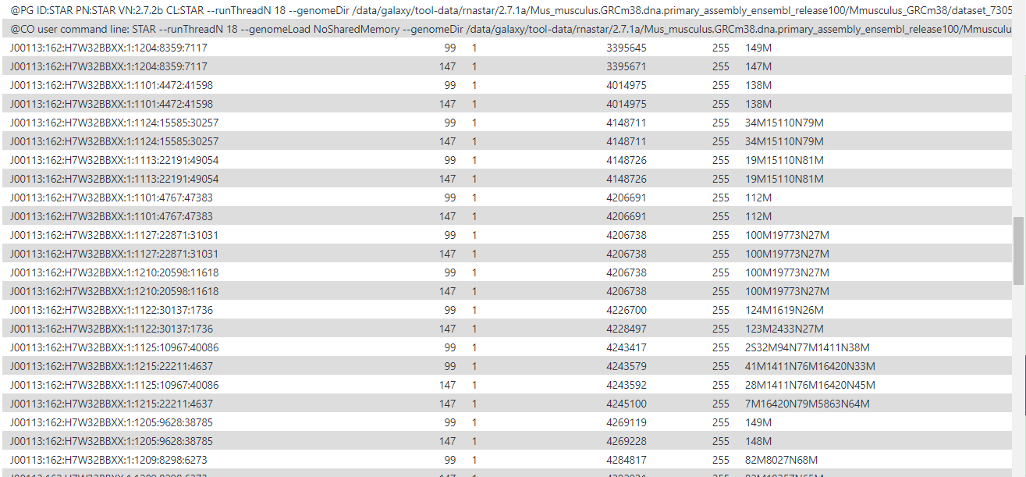
RNA star Results
.bam file → Binary equivalent of SAM (Sequence Alignment/Map) file
More information about data file formats can be found at:
https://genome.ucsc.edu/FAQ/FAQformat.html#format1

Slide 19
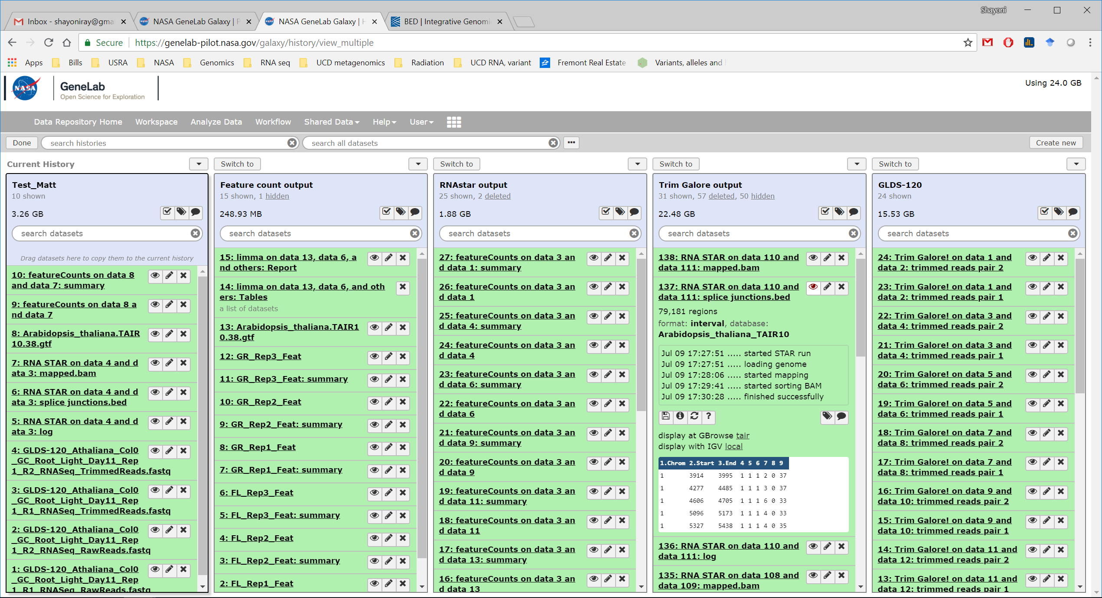
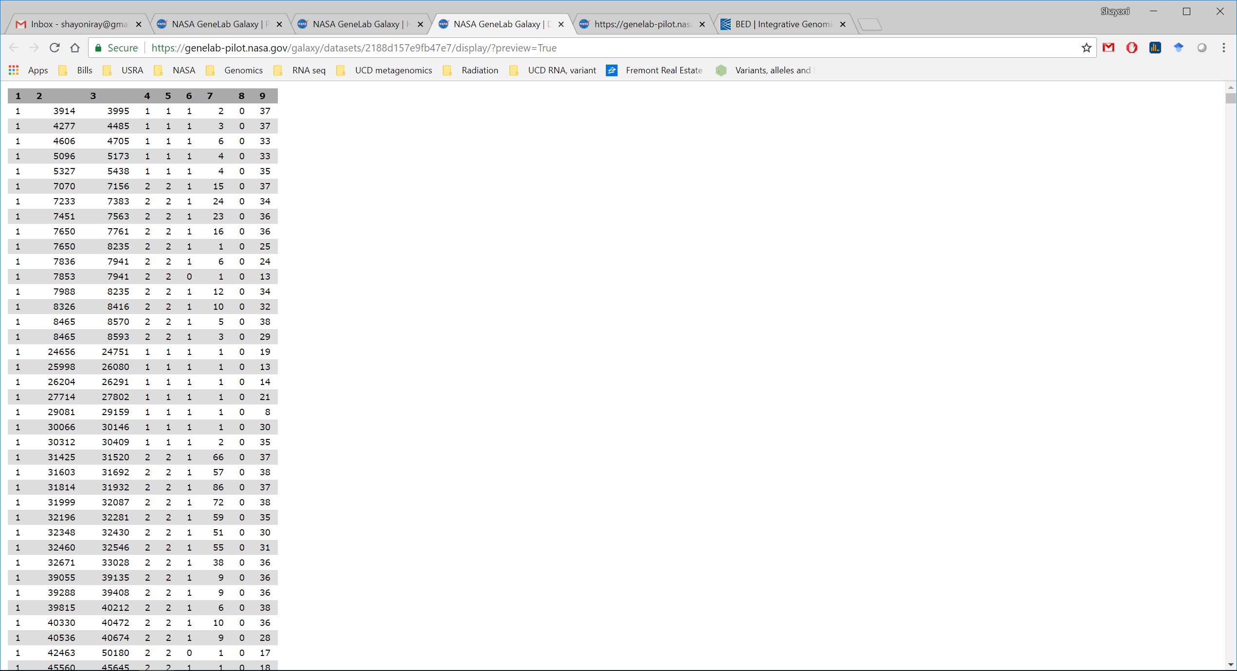
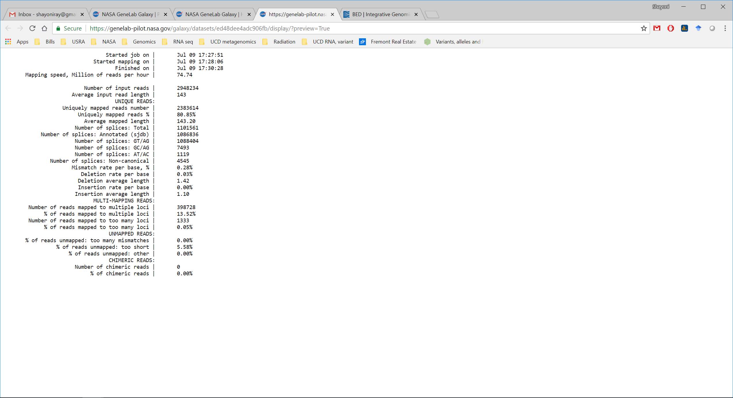
RNA star Results
BED (Browser Extensible Data) format provides a flexible way to define the data lines that are displayed in an annotation track.
Log files provide information about the mapping of the dataset onto the reference genome.

Slide 20
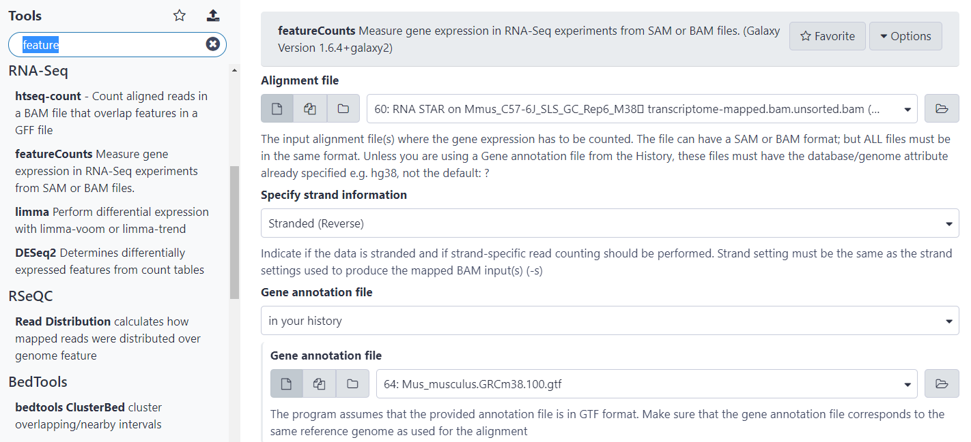
COUNT: CALL FEATURE COUNTS
1
Search for and click on featureCounts in the Tools menu.
2
Use the following parameters and click Execute
Alignment File
RNA STAR Output (mapped.bam files, NOT transciptome-mapped)
Specify strand information
Stranded (Reverse)
Gene annotation file
In your history: Mus_musculus.GRCm38.100.gtf Output format
Keep default (Gene-ID “\t” read-count (MultiQC/DESeq2/edgeR/limma-voom compatible)
Create gene-length file
Yes
Advanced Options
GFF feature type filter: transcript
GFF gene identifier: gene_id
Minimum mapping quality per read: 12
Leave other parameters (seed, alignment, limits, and chimeric alignment) on default settings

Slide 21
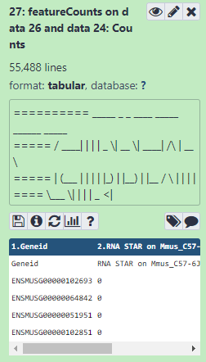
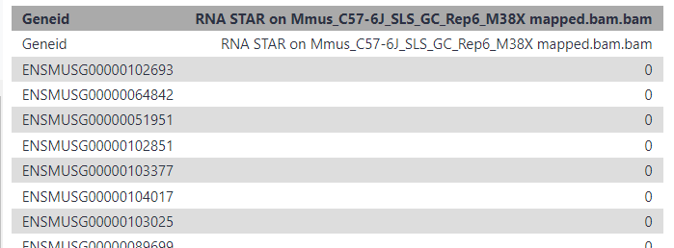
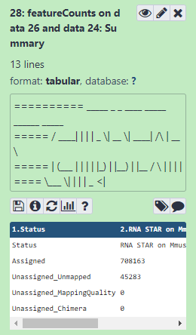
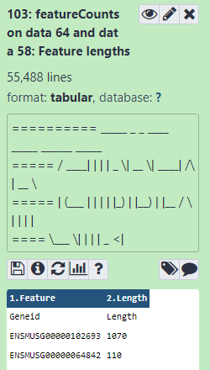
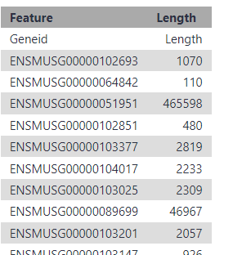
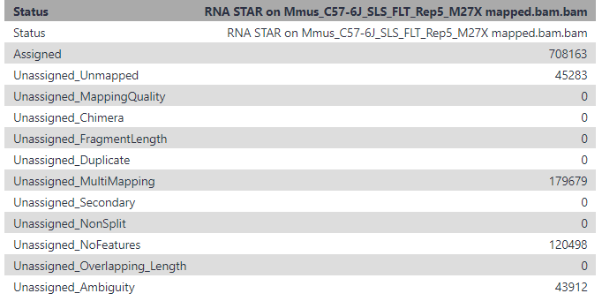
FEATURE COUNTS RESULTS
Generates three outputs:
Summary
Counts
Feature Lengths

Slide 22
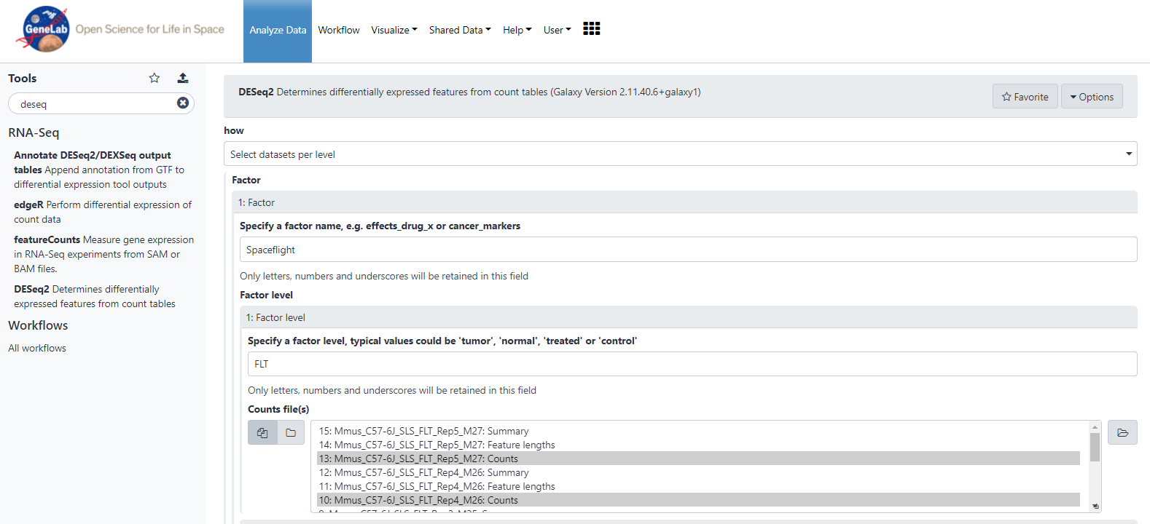
Differential Gene Expression: CALL DeSEq2
2
Use the following parameters and click Execute
1
Search for and click on DESeq2 in the Tools menu.
How
Select datasets per level
Factor
Spaceflight
First Factor Level
FLT
Select all first level Count files (FLT)
Second Factor Level
GC
Select all second level Count files GC)
Files have header?
Yes
Visualizing the analysis results
Yes
Normalized table counts
Yes
rLog Normalized Table
No
Method of estimateSizeFactors
ratio
Fit type
Parametric
Leave other parameters on default settings

Slide 23
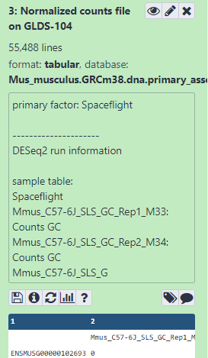
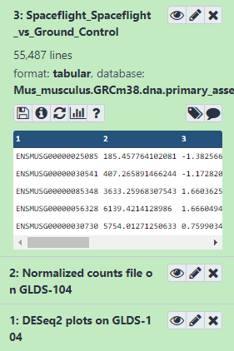
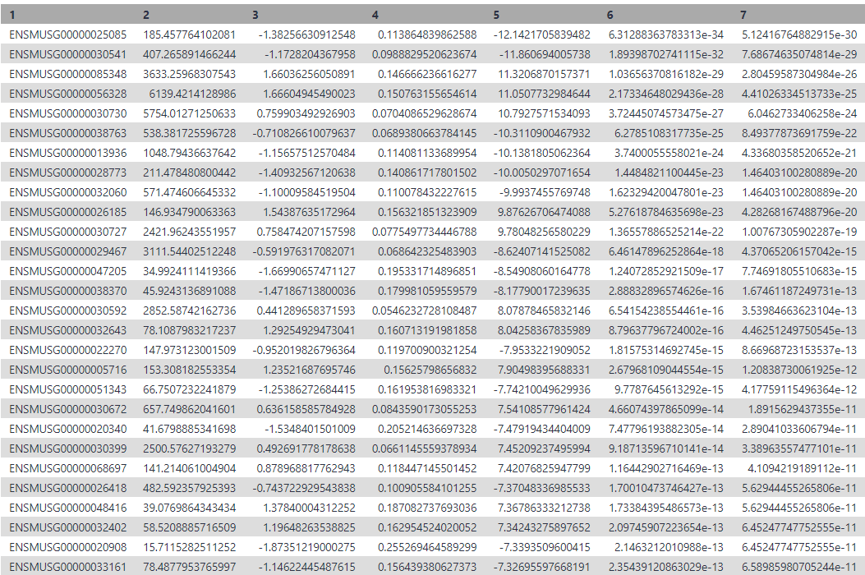
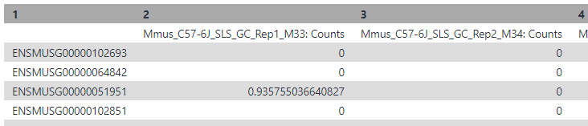
DESEQ2 Results
Generates several outputs including:
Table with normalized counts
Summary table with statistics and DGE results per gene
Graphical summaries of the results

Slide 24
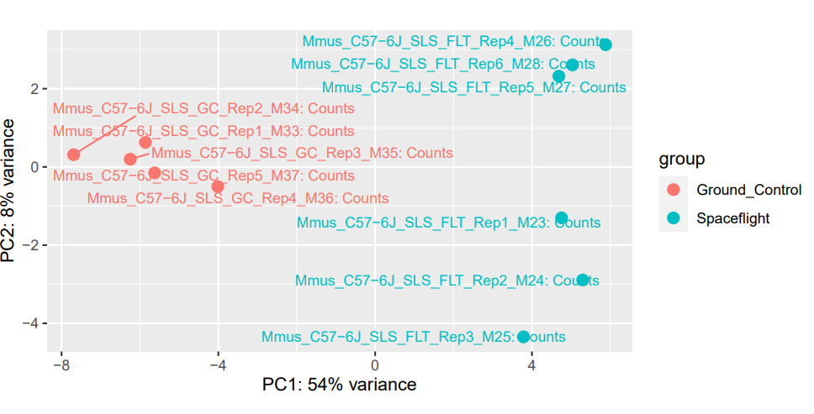
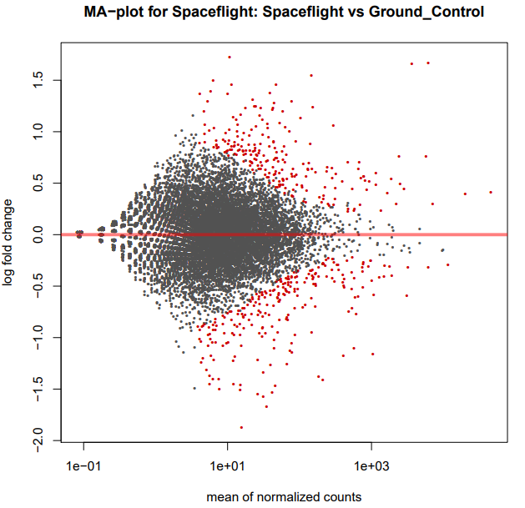
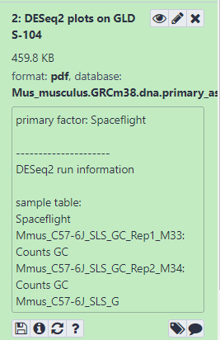
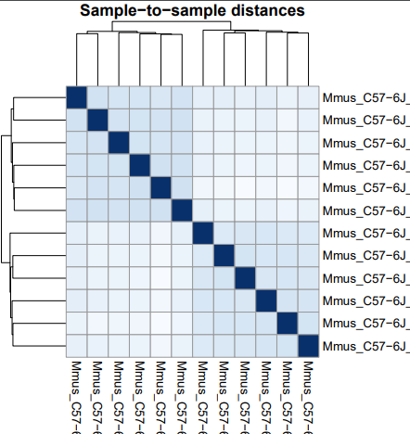
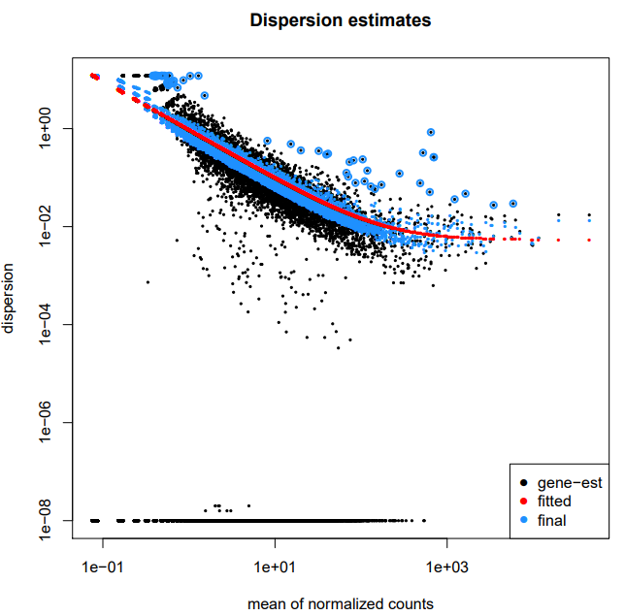

View Graphical Summaries/visualization plots
Click on the eye to view the visualizations.

Slide 25

Filter Differentially Expressed GeneS
1
Search for and click Filter in the Tools menu.
2
Use the following parameters and click Execute
Filter
Select the DESeq2 result file
With following condition
c7 < 0.05
Number of Headers to skip
0
3
Use the following parameters and click Execute
Filter
Select the output of the previous step
With following condition
abs(c3) > 1
Number of Headers to skip
0
Steps 2 & 3 enable you to filter for genes with high statistical significance and high biological significance

Slide 26

Annotate Differentially Expressed Genes
1
Search for and click on Annotate DESeq2/DEXSeq output tables in the Tools menu.
2
Use the following parameters and click Execute
Tabular output of DESeq2.edgeR/limma/DEXSeq
Select the results from the second filter
Input file type
DESeq2/edgeR/limma
Reference annotation in GFF/GTF format
.gtf file from history

Slide 27

Generate a Volcano Plot
1
Search for and click on Volcano Plot in the Tools menu.
2
Use the following parameters and click Execute
Specify an input file
Select the filtered and annotated file
FDR (adjusted P value)
Column 7
P value (raw)
Column 6
Log Fold Change
Column 3
Labels
Column 13
Significance Threshold
0.05
LogFC threshold to color
1
Points to Label
Significant
Only label top most significant
20
Leave other parameters on default settings

Slide 28


View Volcano Plot
Indicates most upregulated gene
Indicates most downregulated gene

